Slide 1
Introduction to Parallel Computing
Adapted from https://computing.llnl.gov/tutorials/parallel_comp/

Slide 2
Designing Parallel Programs
Communications

Slide 3
Who Needs Communications?
The need for communications between tasks depends upon your problem:
You DON'T need communications
Some types of problems can be decomposed and executed in parallel with virtually no need for tasks to share data. For example, imagine an image processing operation where every pixel in a black and white image needs to have its color reversed. The image data can easily be distributed to multiple tasks that then act independently of each other to do their portion of the work.
These types of problems are often called embarrassingly parallel because they are so straight-forward. Very little inter-task communication is required.
You DO need communications
Most parallel applications are not quite so simple, and do require tasks to share data with each other. For example, a 3-D heat diffusion problem requires a task to know the temperatures calculated by the tasks that have neighboring data. Changes to neighboring data has a direct effect on that task's data.

Slide 4
Factors to Consider:
There are a number of important factors to consider when designing your program's inter-task communications:
Cost of communications
Inter-task communication virtually always implies overhead.
Machine cycles and resources that could be used for computation are instead used to package and transmit data.
Communications frequently require some type of synchronization between tasks, which can result in tasks spending time "waiting" instead of doing work.
Competing communication traffic can saturate the available network bandwidth, further aggravating performance problems.
Latency vs. Bandwidth
latency is the time it takes to send a minimal (0 byte) message from point A to point B. Commonly expressed as microseconds.
bandwidth is the amount of data that can be communicated per unit of time. Commonly expressed as megabytes/sec or gigabytes/sec.
Sending many small messages can cause latency to dominate communication overheads. Often it is more efficient to package small messages into a larger message, thus increasing the effective communications bandwidth.

Slide 5
Factors to Consider:
Visibility of communications
With the Message Passing Model, communications are explicit and generally quite visible and under the control of the programmer.
With the Data Parallel Model, communications often occur transparently to the programmer, particularly on distributed memory architectures. The programmer may not even be able to know exactly how inter-task communications are being accomplished.

Slide 6
Factors to Consider:
Synchronous vs. asynchronous communications
Synchronous communications require some type of "handshaking" between tasks that are sharing data. This can be explicitly structured in code by the programmer, or it may happen at a lower level unknown to the programmer.
Synchronous communications are often referred to as blocking communications since other work must wait until the communications have completed.
Asynchronous communications allow tasks to transfer data independently from one another. For example, task 1 can prepare and send a message to task 2, and then immediately begin doing other work. When task 2 actually receives the data doesn't matter.
Asynchronous communications are often referred to as non-blocking communications since other work can be done while the communications are taking place.
Interleaving computation with communication is the single greatest benefit for using asynchronous communications.

Slide 7
Factors to Consider:
Scope of communications
Knowing which tasks must communicate with each other is critical during the design stage of a parallel code. Both of the two scopings described below can be implemented synchronously or asynchronously.
Point-to-point - involves two tasks with one task acting as the sender/producer of data, and the other acting as the receiver/consumer.
Collective - involves data sharing between more than two tasks, which are often specified as being members in a common group, or collective. Some common variations (there are more):

Slide 8
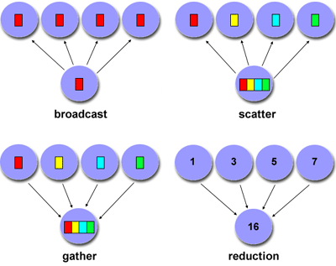

Slide 9
Factors to Consider:
Efficiency of communications
Very often, the programmer will have a choice with regard to factors that can affect communications performance. Only a few are mentioned here.
Which implementation for a given model should be used? Using the Message Passing Model as an example, one MPI implementation may be faster on a given hardware platform than another.
What type of communication operations should be used? As mentioned previously, asynchronous communication operations can improve overall program performance.
Network media - some platforms may offer more than one network for communications. Which one is best?

Slide 10
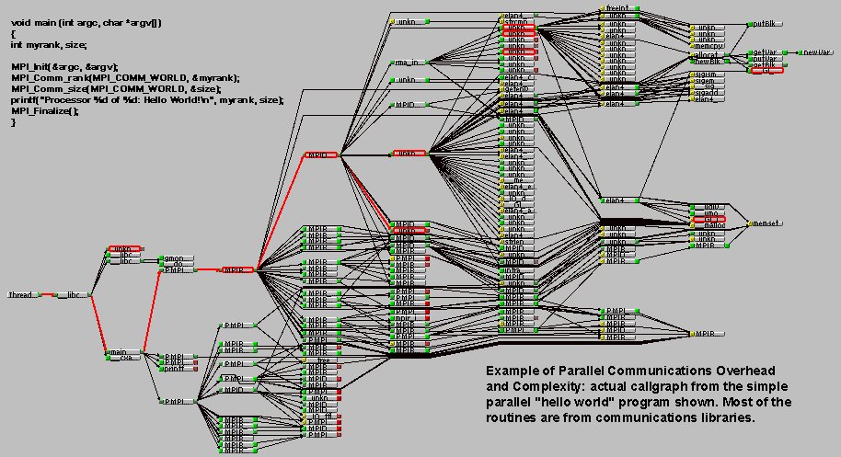
Overhead and Complexity

Slide 11
Synchronization
Types of Synchronization:
Barrier
Usually implies that all tasks are involved
Each task performs its work until it reaches the barrier. It then stops, or "blocks".
When the last task reaches the barrier, all tasks are synchronized.
What happens from here varies. Often, a serial section of work must be done. In other cases, the tasks are automatically released to continue their work.
Lock / semaphore
Can involve any number of tasks
Typically used to serialize (protect) access to global data or a section of code. Only one task at a time may use (own) the lock / semaphore / flag.
The first task to acquire the lock "sets" it. This task can then safely (serially) access the protected data or code.
Other tasks can attempt to acquire the lock but must wait until the task that owns the lock releases it.
Can be blocking or non-blocking
Synchronous communication operations
Involves only those tasks executing a communication operation
When a task performs a communication operation, some form of coordination is required with the other task(s) participating in the communication. For example, before a task can perform a send operation, it must first receive an acknowledgment from the receiving task that it is OK to send.
Discussed previously in the Communications section.

Slide 12
Data Dependencies
Definition:
A dependence exists between program statements when the order of statement execution affects the results of the program.
A data dependence results from multiple use of the same location(s) in storage by different tasks.
Dependencies are important to parallel programming because they are one of the primary inhibitors to parallelism.

Slide 13
Examples:
Loop carried data dependence
DO 500 J = MYSTART,MYEND
A(J) = A(J-1) * 2.0
500 CONTINUE
The value of A(J-1) must be computed before the value of A(J), therefore A(J) exhibits a data dependency on A(J-1). Parallelism is inhibited.
If Task 2 has A(J) and task 1 has A(J-1), computing the correct value of A(J) necessitates:
Distributed memory architecture - task 2 must obtain the value of A(J-1) from task 1 after task 1 finishes its computation
Shared memory architecture - task 2 must read A(J-1) after task 1 updates it

Slide 14
Examples:
Loop independent data dependence
task 1 task 2
------ ------
X = 2 X = 4
. .
. .
Y = X**2 Y = X**3
As with the previous example, parallelism is inhibited. The value of Y is dependent on:
Distributed memory architecture - if or when the value of X is communicated between the tasks.
Shared memory architecture - which task last stores the value of X.
Although all data dependencies are important to identify when designing parallel programs, loop carried dependencies are particularly important since loops are possibly the most common target of parallelization efforts.

Slide 15
How to Handle Data Dependencies:
Distributed memory architectures - communicate required data at synchronization points.
Shared memory architectures -synchronize read/write operations between tasks.

